Slide 1

INSTITUTE UIE
DEPARTMENT ACADEMIC UNIT-1
Bachelor of Engineering (Computer Science & Engineering)
Subject Name Introduction Electrical & Electronics Engineering
Subject Code-23ECH-101
Prepared By
Dr. Shikha
Unit-1 Chapter-3
Introduction of Electrical & Electronics Circuit
Lecture No. 1.3.5
SOP & POS
DISCOVER . LEARN . EMPOWER

Slide 2
Lecture Objectives
S. No. | Objectives
1 | To make student aware about representation of Boolean expression in SOP and POS forms
2 | To make student aware about representation of Boolean expression in Min and Max Terms.
3 | To impart knowledge about converting Boolean expression into standard form.

Slide 3
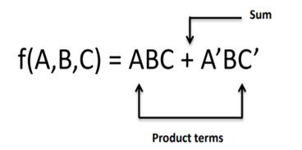
Course Objectives
S. No. | Objectives
1 | Understand Electrical & Electronics Engineering Fundamentals
2 | To prepare students to perform the analysis and design of various Electrical & digital electronic circuits.

Slide 4
Course Outcomes
CO Number | Title | Level
CO1 | To identify the different types of electrical elements and the basic op-amp circuit elements and to illustrate the various types of motors, transducers. | Remember
CO2 | To understand basic principles of transformers, transducers, op-amps, DC and AC motors and to compare the different methods for analysing electrical and magnetic circuits. | Understand
CO3 | To derive the relationships between parameters in electric and magnetic circuits and motors and to determine specifications of op-amps. | Analyze
CO4 | To solve the basic problems related to electric circuits, magnetic circuits and motors and to assess the characteristics of different configurations of op-amps. | Evaluate
CO5 | To design the different applications of transducers, motors as well as the op-amps like adders, subtractor and comparators. | Create

Slide 5

Classification of Boolean Expression
Boolean Expression
SOP (Sum of Product)
POS(Product of Sum)
Each Product term is Summed up in the expression.
Each Sum term is multiplied in the expression.

Slide 6
Diff b/w SOP & POS form
S.No. | SOP Form | POS FORM
1. | Each individual term which contains either complemented or true form called as Minterm. | Each individual term which contains either complemented or true form called as Maxterm.
2. | Minterm is represented as m_{i .} | Maxterm is represented as M_{i .}
3. | F =∑ m ( 0,1,5,7) | F =∏ M ( 0,1,5,7)
4. | Variables are operated by AND (product ) to form Product term and all these product terms are ORed | Variables are operated by OR (SUM) to form sum term and all these sum terms are ANDed.
5. | Each literal in true form is having value 1 whereas Complemented form is represented by value 0. A= 1, A’=0 | Each literal in true form is having value 0 whereas Complemented form is represented by value 1. A= 0, A’=1

Slide 7
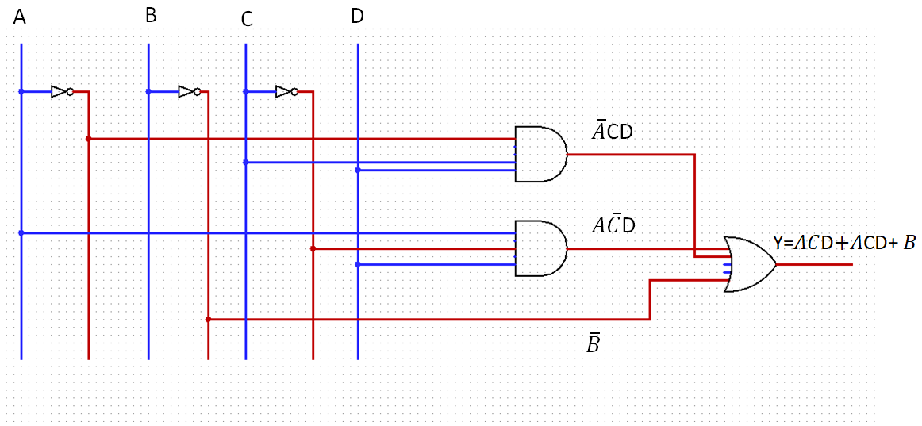
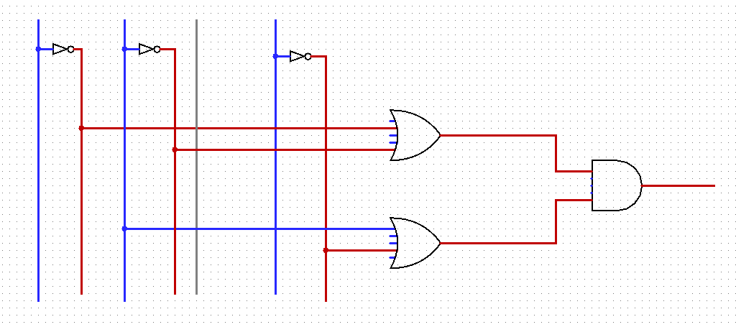

SOP FORM | POS FORM
A
B
C
D
(SOP of F)= (POS of F’)’

Slide 8
Canonical SOP &POS form
Canonical means each term must have all literals
F = XYZ′ + X′YZ + X′YZ′ + XY′Z + XYZ canonical SOP form.
F = (X′ + Y + Z′) (X′ + Y + Z) (X′ + Y′ + Z′) canonical POS form.
RELATION OF MINTERN AND MAXTERMS WITH RESPECT TO INPUT VARIABLES:
Input variables |  |  | Minterms | Maxterms
A | B | C | m_{i} | M_{I}
0 | 0 | 0 | A’B’C’= m₀ | A+B+C= M₀
0 | 0 | 1 | A’B’C= m₁ | A+B+C’= M₁
0 | 1 | 0 | A’BC’ = m₂ | A+B’+C= M₂
0 | 1 | 1 | A’BC= m₃ | A+B’+C’ = M₃
1 | 0 | 0 | AB’C’ = m₄ | A’+B+C = M₄
1 | 0 | 1 | AB’C = m₅ | A’+B+C’ = M₅
1 | 1 | 0 | ABC’ = m₆ | A’+B’+C = M₆
1 | 1 | 1 | ABC = m₇ | A’+B’+C’ = M₇

Slide 9
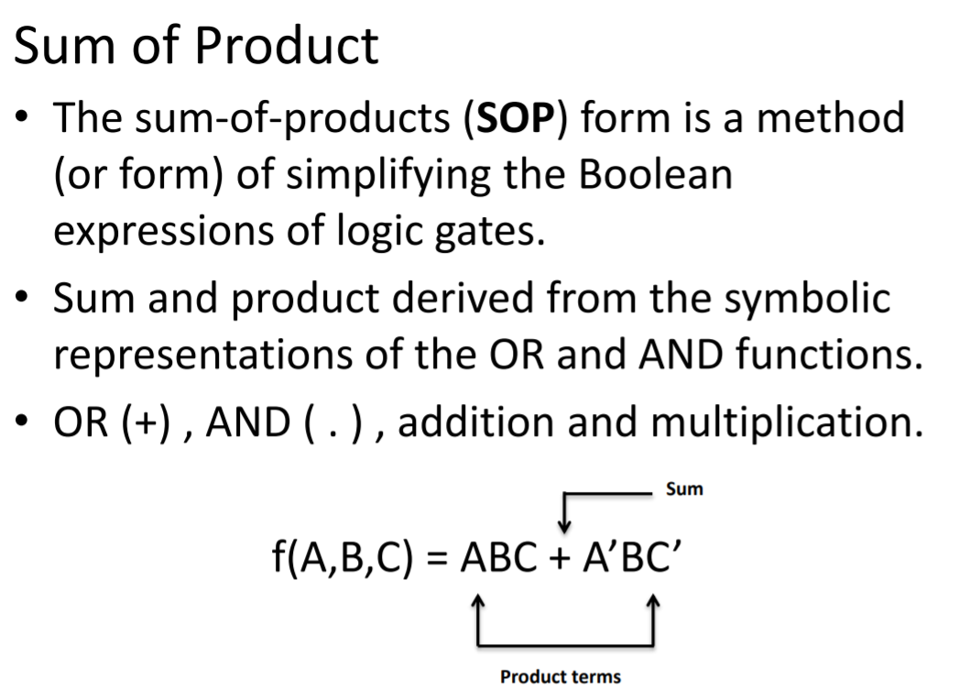

Slide 10
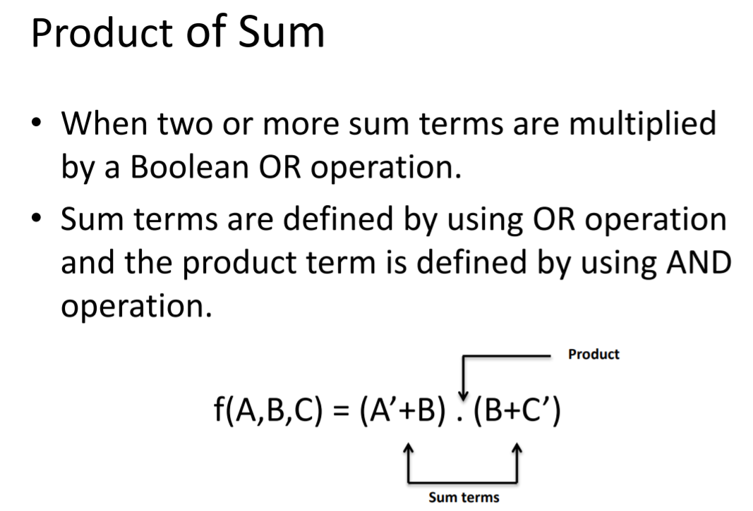

Slide 11
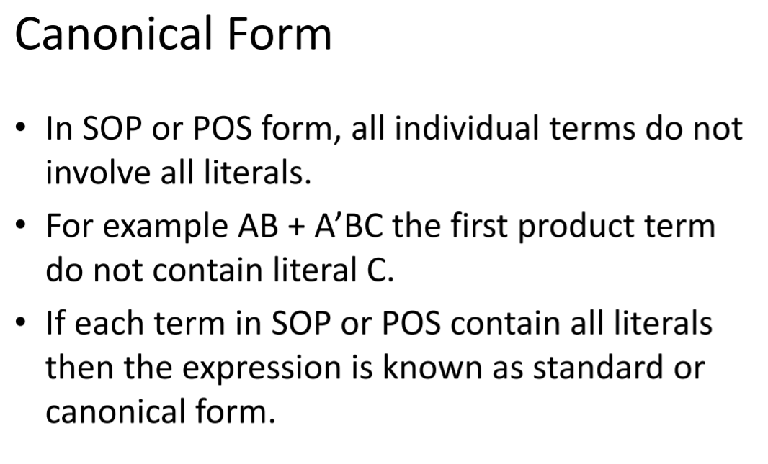

Slide 12
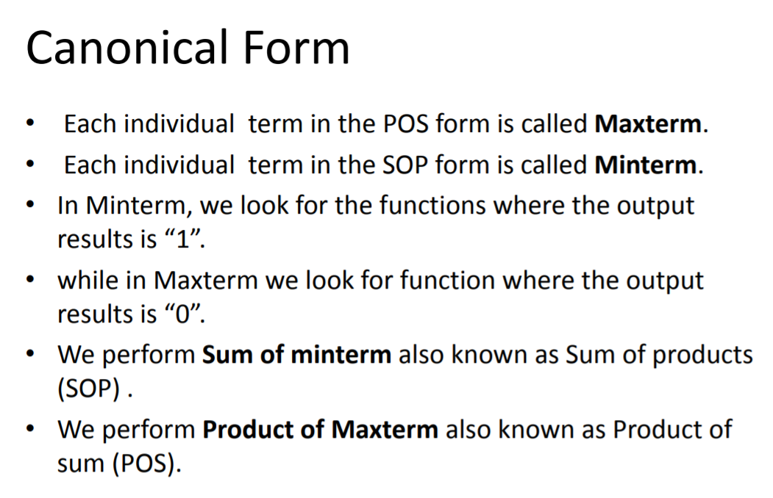

Slide 13
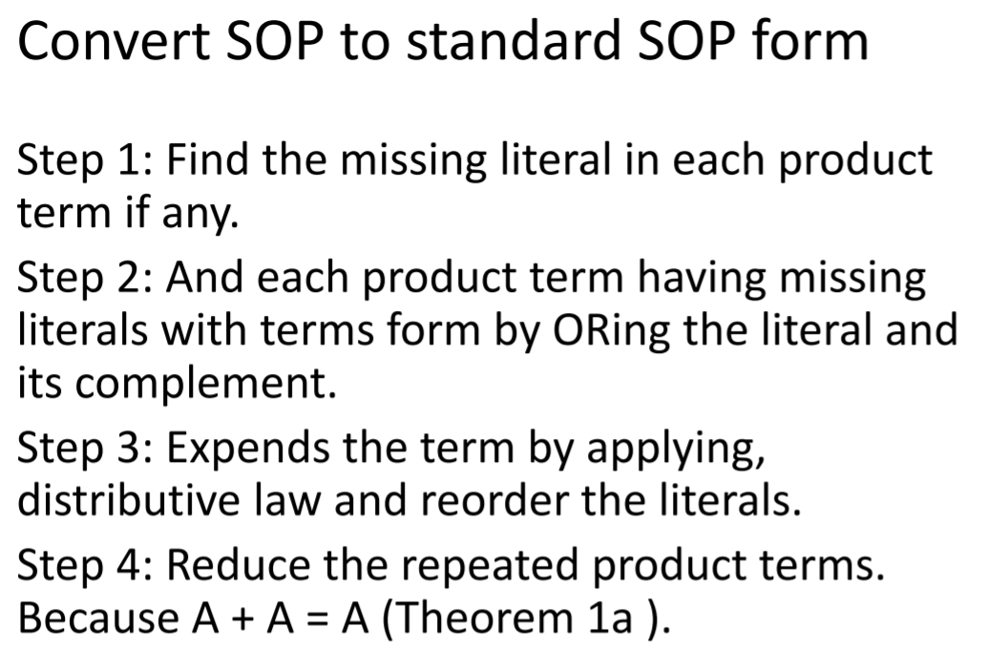

Slide 14
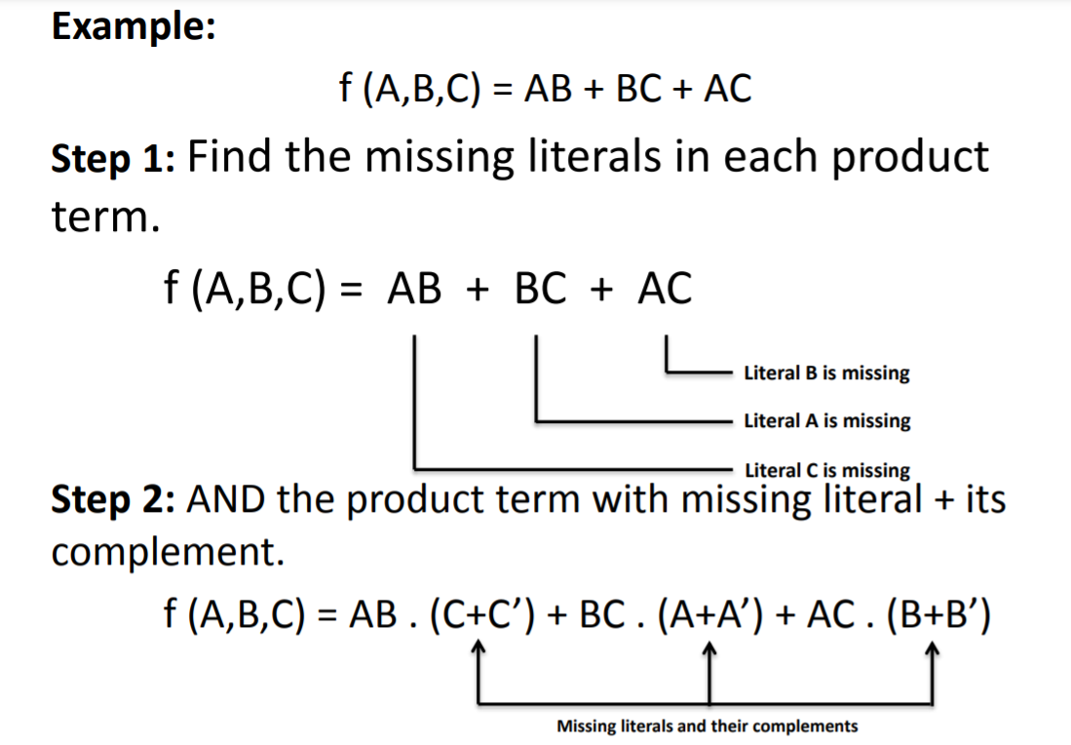

Slide 15
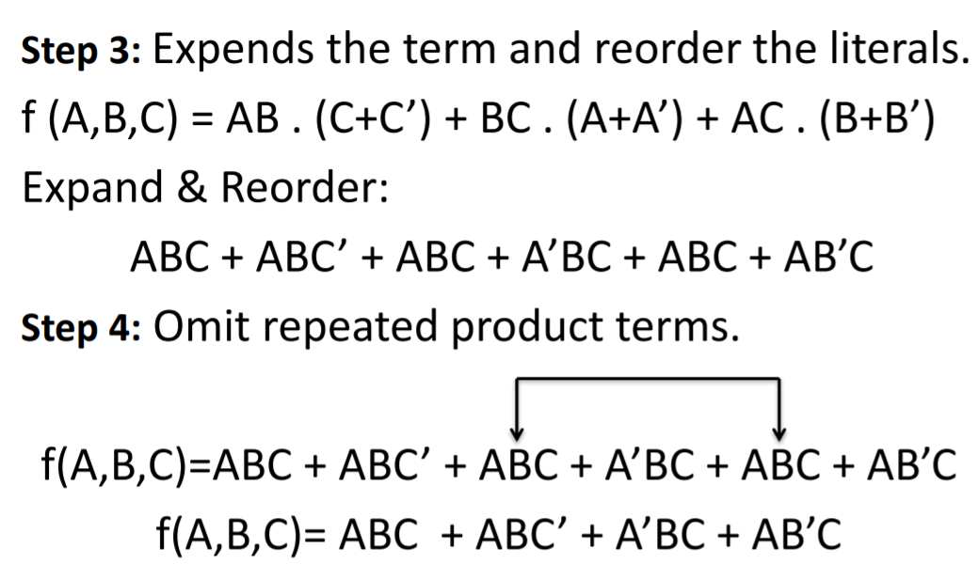

Slide 16
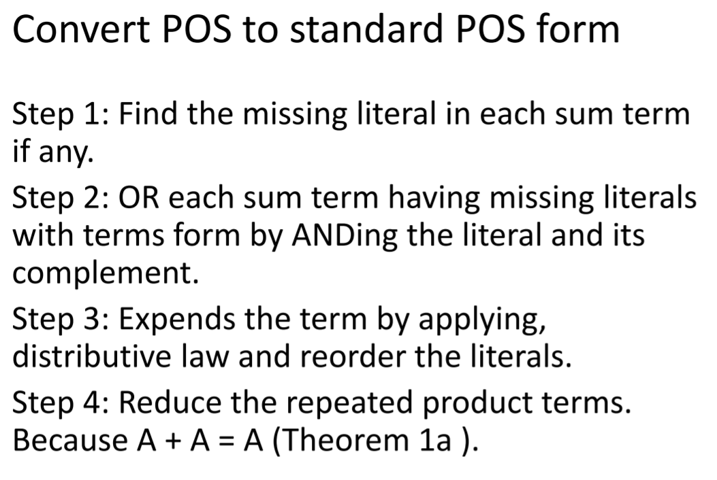

Slide 17
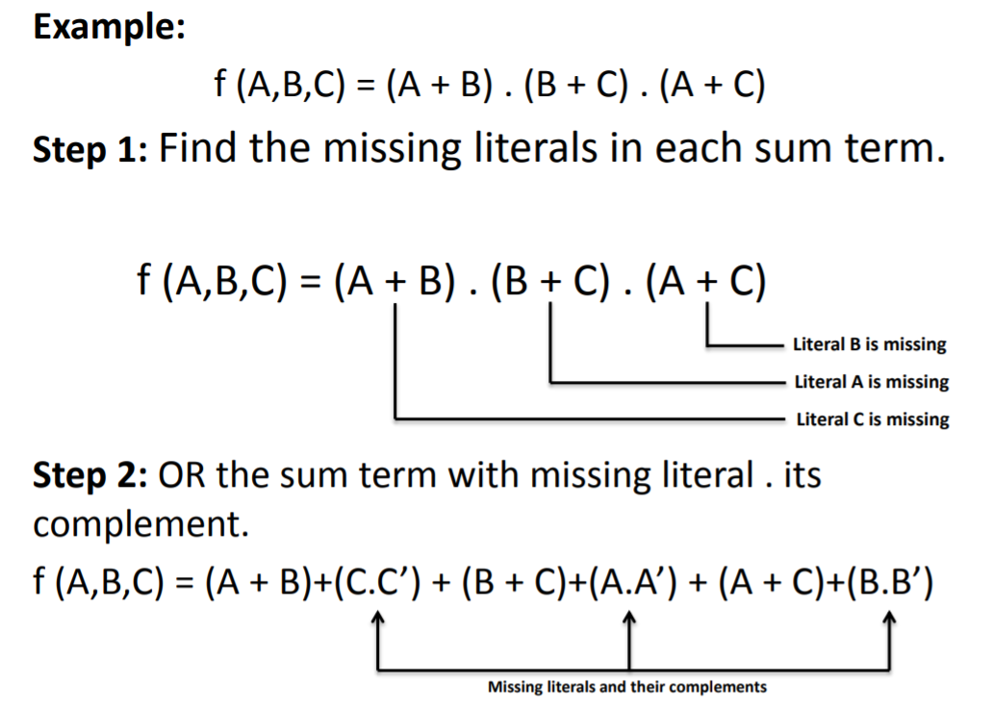

Slide 18
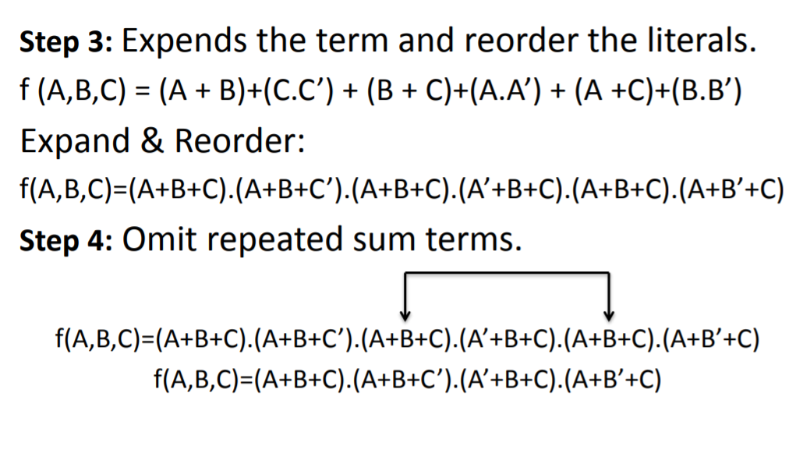

Slide 19
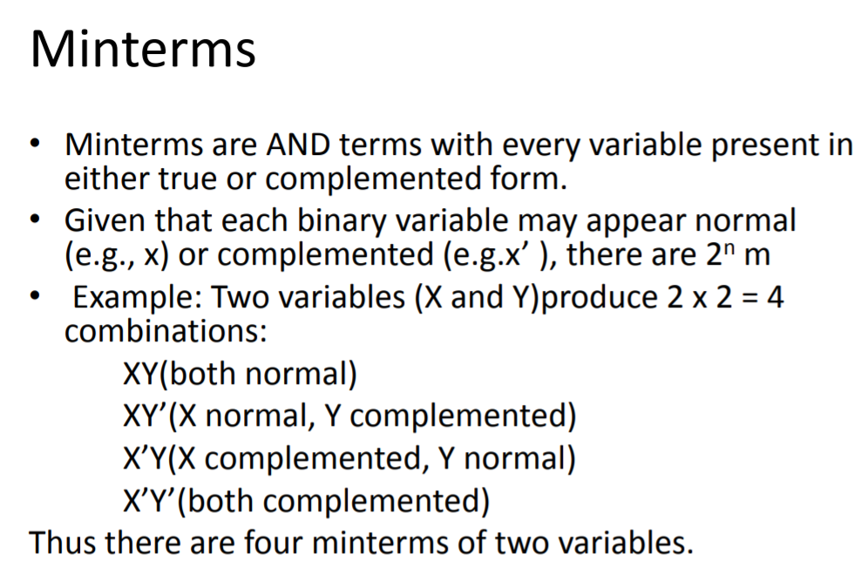

Slide 20
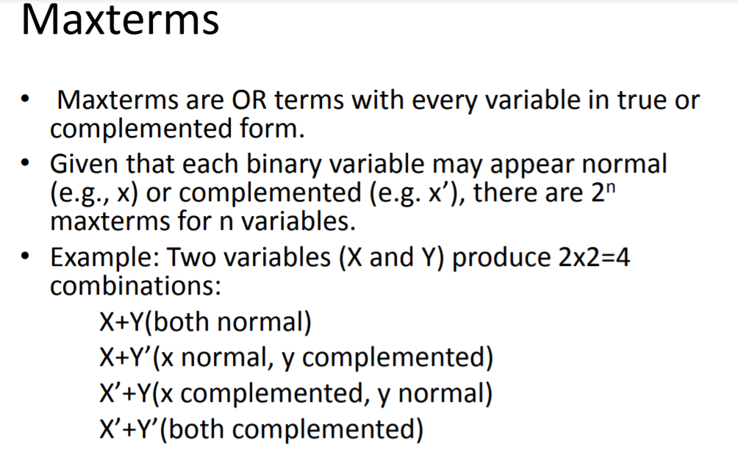

Slide 21
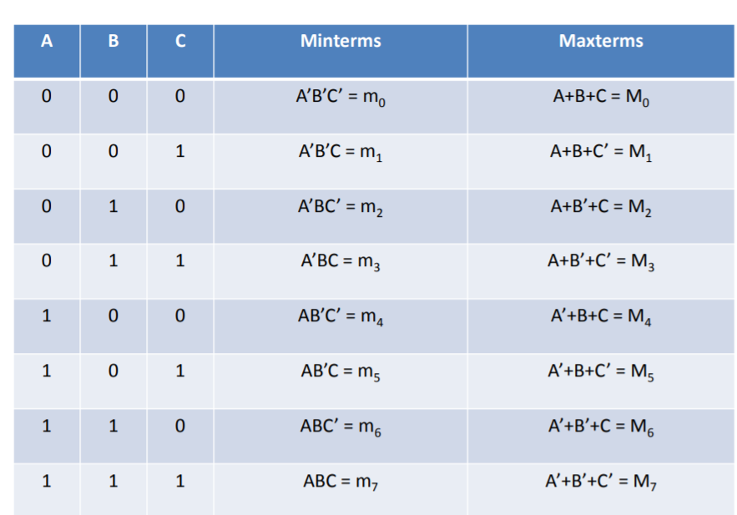

Slide 22
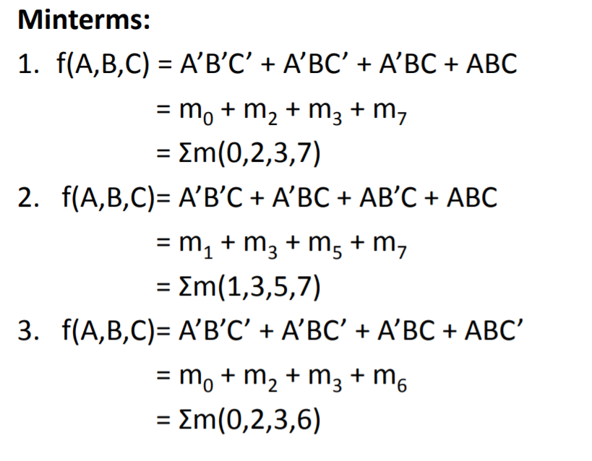

Slide 23
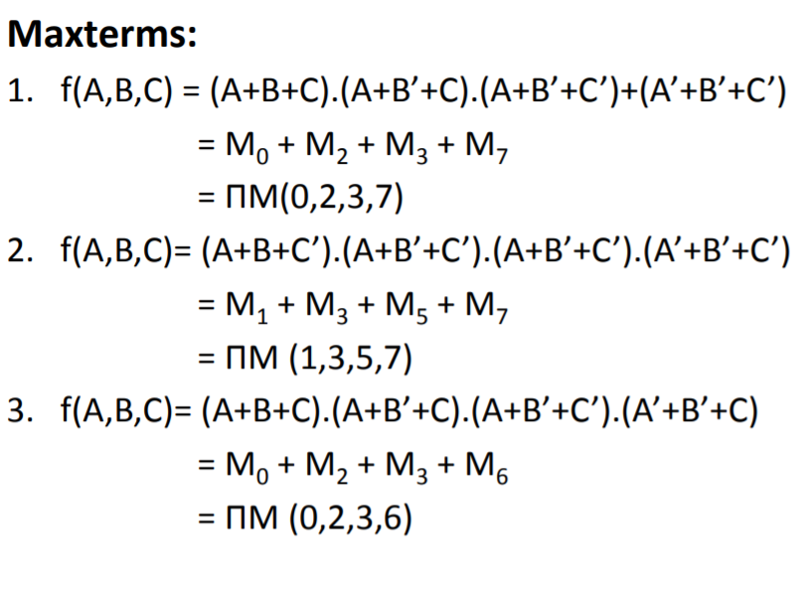

Slide 24

REFERENCES
https://www.vivaxsolutions.com/physics/allogicgates.aspx
https://www.androiderode.com/ttl-not-gate/
Mano,Morris, Digital Design, Prentice Hall of India.
Fletcher, An Engg. Approach to digital design, Prentice Hall of India.
http://www.geeksforgeeks.org/digital-electronics-logic-design-tutorials/
http://www.ni.com/example/14493/en/
http://195.134.76.37/applets/AppletGates/Appl_Gates2.html
https://www.javatpoint.com/and-gate-in-digital-electronics
https://www.allaboutcircuits.com/textbook/digital/
https://www.tutorialspoint.com/digital_electronics/index.asp
https://www.tutorialspoint.com/computer_logical_organization/complement_arithmetic.htm

Slide 25
THANK YOU

